Slide 1




Hexaware CODE & RISE PROGRAM
Spark_Velammal_Inst
"Unite_Innovate_Excel."

Slide 2
Team Details
Team Name: Spark_Velamma_Instl
Application Name : Soft Skills Enhancement
Team Members
Email ID
REKHA R D
rekhard406@gmail.com
UKKISALA LAKSHMI
ukkisalalakshmi@gmail.com
MANCHU PALLAVI
pallavimanchu15@gmail.com
KAMIREDDY CHARITHA
kamireddycharitha@gmail.com

Slide 3
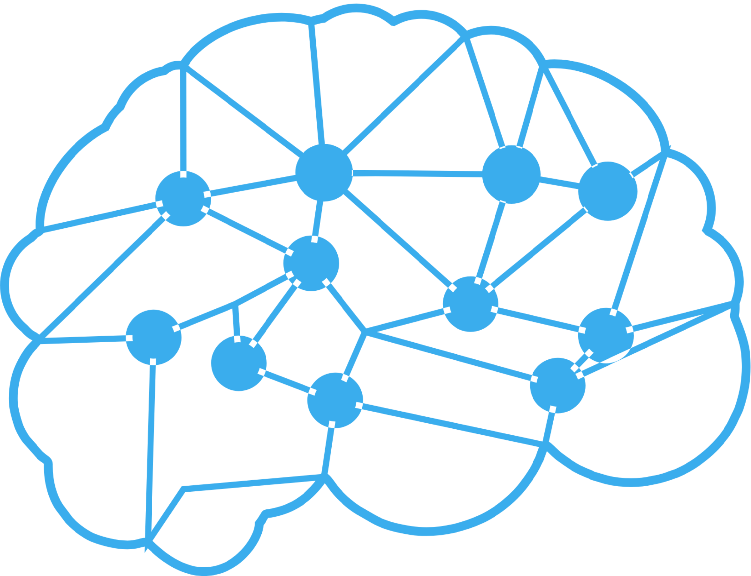
Impact/Potential Value of the Application
Transforming Potential into Mastery with Soft Skills Training.
Elevating Communication and Collaboration for Success.
Unlocking Personal Growth Through Essential Soft Skills.
Boost Your Professional Presence with Targeted Soft Skills.
Enhance Your Leadership and Communication for Greater Impact.
T

Slide 4
The Solution Proposed by your Team
Comprehensive Learning Platform:
Integrated Learning Management System (LMS): A user-friendly platform that consolidates all learning resources, modules, and tools in one place.
Interactive Training Modules:
Scenario-Based Simulations: Realistic, interactive scenarios where users can practice and refine their soft skills in a controlled environment.
Real-Time Feedback Mechanism:
Instant Evaluation Tools: Automated feedback on exercises and simulations to guide users in real time.
Key Features / Approach
Networking and Relationship Building
Feature: Building and maintaining professional relationships, and leveraging networks for mutual benefit.
Leadership and Initiative
Feature: Leading by example, inspiring others, and taking responsibility for actions.
Adaptability and Flexibility
Feature: Being open to change, learning new skills, and adjusting to new environments or roles.
Solution Highlights

Slide 5
Technologies Used
Virtual Reality (VR) and Augmented Reality (AR):
VR and AR are used to simulate real-life scenarios for soft skills training, such as public speaking, conflict resolution, and leadership. These immersive environments provide safe spaces to practice and receive instant feedback.
AI-Powered Coaching Tools:
AI-driven tools offer personalized coaching in areas like emotional intelligence, communication, and empathy. These tools can analyze user interactions and provide tailored feedback for improvement.
Mobile Apps for Soft Skills:
Mobile apps provide on-the-go learning opportunities for soft skills development, offering bite-sized lessons, interactive exercises, and access to mentors or coaches
Mentorship and Networking Platforms:
These platforms connect individuals with mentors or peers for guidance, feedback, and networking opportunities, which are crucial for developing interpersonal skills.

Slide 6
Gen AI Tool Utilization
Gen AI can analyze a user’s learning style, strengths, and weaknesses to create customized learning paths for developing soft skills such as communication, leadership, and emotional intelligence.
Gen AI can generate realistic simulations and role-playing scenarios where users can practice soft skills in a safe environment. The AI adapts the scenario based on user input, providing dynamic challenges that mimic real-life situations.
Gen AI can analyze communication patterns, tone, and language used in conversations or presentations. It provides feedback on areas like clarity, persuasiveness, and emotional impact.
Gen AI can detect and analyze emotions from text, voice, or facial expressions, offering real-time feedback on emotional intelligence and empathy during interactions.

Slide 7
System Architecture, Functionalities and Design Diagram
User Interface (UI) Layer:
Users log in to the platform via a web or mobile app. The UI layer collects input and displays content generated by the application layer.
Application Layer:
The AI Engine processes user data, interactions, and progress to generate personalized learning paths and provide real-time feedback. It also powers the virtual assistant for conversational interactions.
Data Layer:
When a user interacts with the platform, the system retrieves and stores relevant data in the User Profile Database. This data is used to personalize the user experience.
Integration Layer:
The API Gateway acts as a bridge between the application layer and external services. For example, if the platform needs to process NLP tasks, it sends a request via the API Gateway to an external AI service (like IBM Watson or Google NLP).
External Services:
The platform leverages external AI services to enhance its capabilities, such as using sentiment analysis during role-play simulations to provide real-time feedback on a user's emotional responses.

Slide 8
How It Works
Technical Architecture
User Interface (UI) Layer
Application Layer
Data Layer
Integration Layer
External Services

Slide 9
Innovation and Creativity
Innovative Learning Technologies
Creative Learning Methods
User-Centric Design
Engagement and Motivation Strategies
Continuous Innovation and Improvement

Slide 10
Scalability, Performance and Security
Scalability:
Cloud-Based Infrastructure
Efficient Data Management
Performance Optimization
Performance:
Key Performance Indicators (KPIs)
Progress Tracking
Continuous Improvement
Security:
Data Protection and Privacy
Secure Authentication and Authorization
Data Backup and Recovery

Slide 11
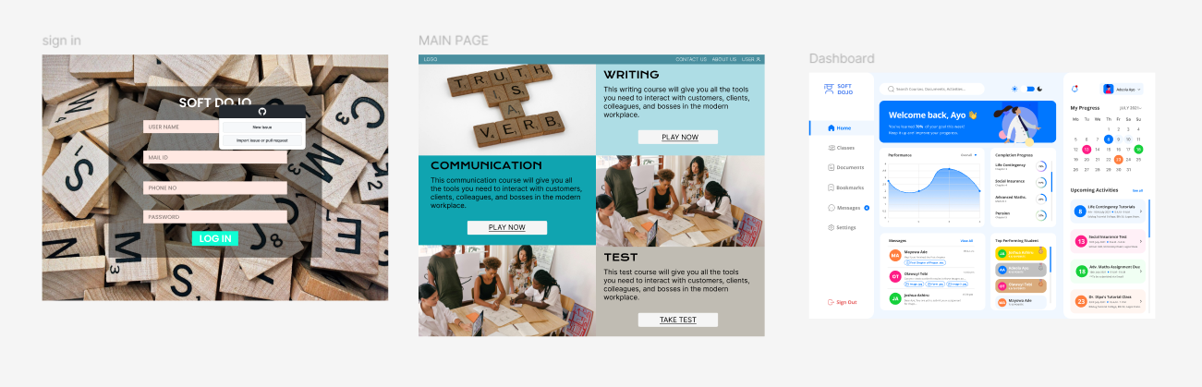
User Experience

Slide 12
Console Output Details
The link to the GitHub repository containing our solution :
https://github.com/REKHA-RD6/SPARK_HEXAWARE.git

Slide 13
Phase 1 - Judging Criteria
Solution Approach
Technologies used
Usage of Gen AI tools
Technical Approach/Architecture Design
Innovation and Creativity
User Experience
Documentation and Presentation
Console Output

Slide 14
Thank You

